Slide 1
What are the obstacles and possibilities for battery recycling collaboration between the US and China
Presented by Energy Group
April 27, 2024
你的名字

Slide 2
Statement of Purpose
CONTENTS
Lithium-ion Battery Recycling Current Situation
Obstacles and successful cases
Recommendation

Slide 3
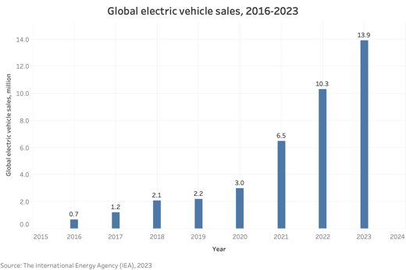
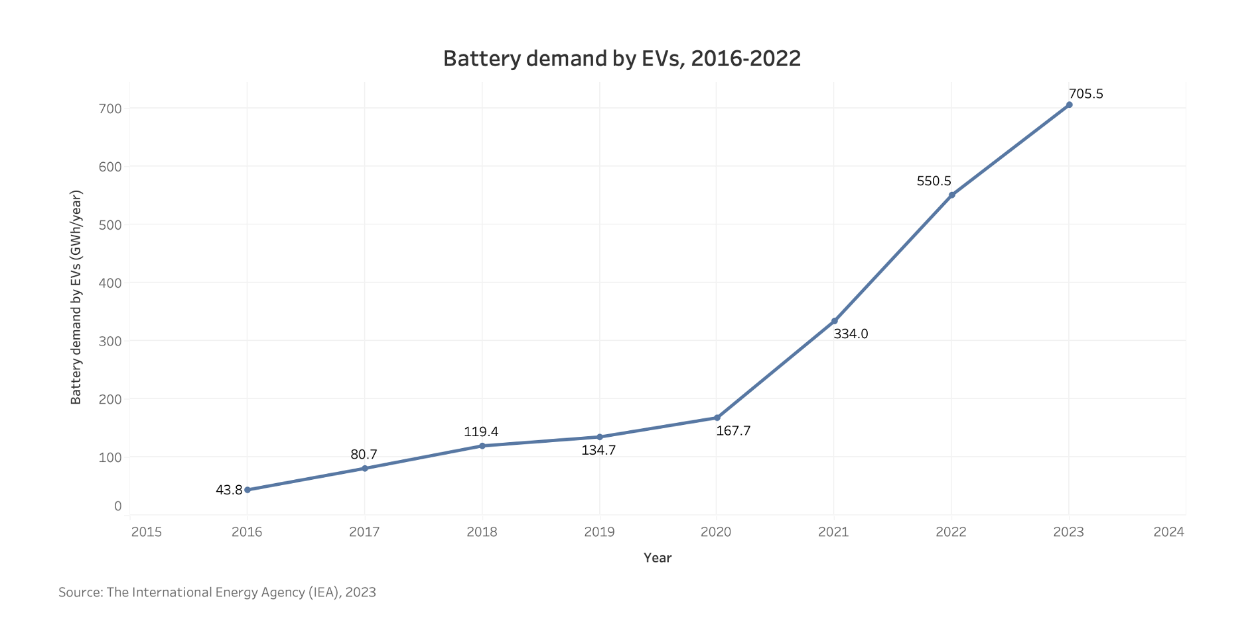
Statement of Purpose
Lithium-ion batteries (LIBs) are widely used in electric vehicles.
With the rapid growth in electric vehicle (EV) sales, LIB demand for EVs continues to rise.

Slide 4
Statement of Purpose
Environmentally, LIBs contain fluorine-based substances like hexafluorophosphates and polyvinylidene fluoride (PVDF), which can lead to fluorine pollution and ozone layer damage.
Economically, LIBs contain significant concentrations of valuable metals. The inherent material value for 1 ton of LIBs is $7708 in the United States.

Slide 5
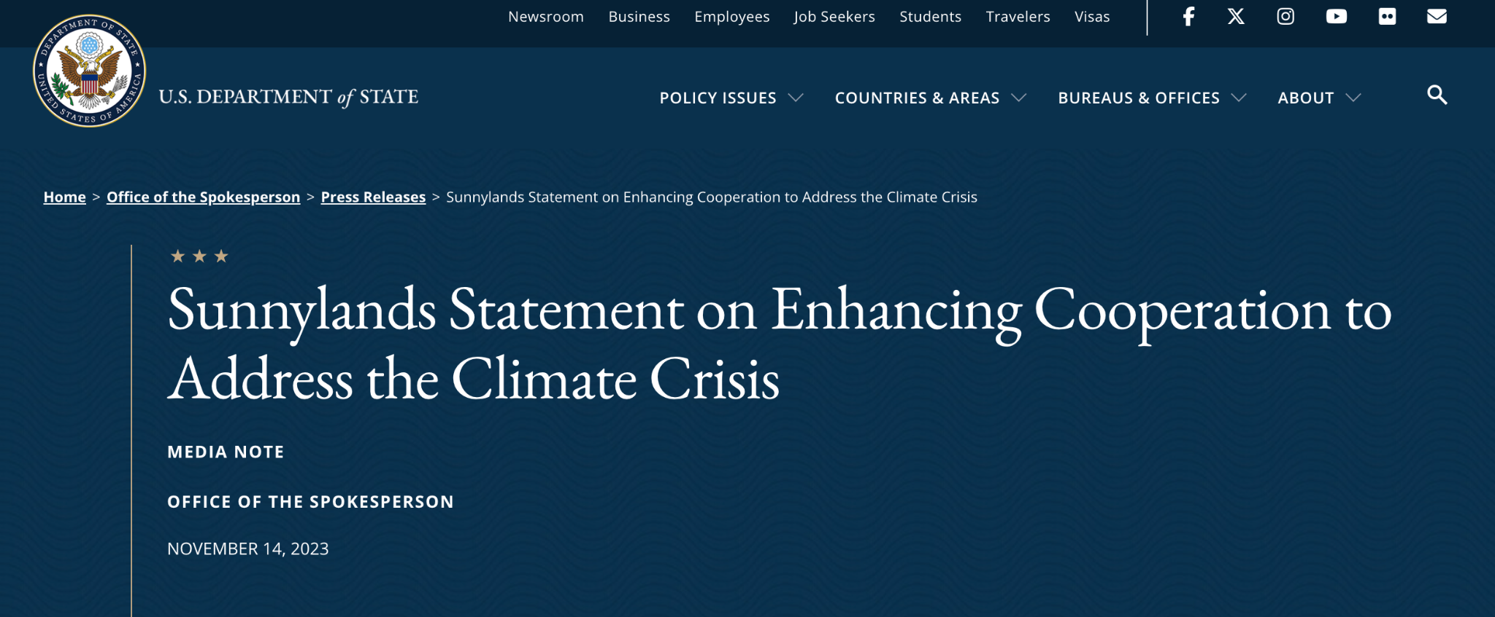
Statement of Purpose
How does LIBs recycling benefit the Common Ground?
the importance of developing resource efficiency to address the climate crisis
the intention of both countries to support collaborative projects on this matter among enterprises, universities, and research institutions

Slide 6
LIBs Recycling
Current Situation: Policy
China
The United States
Encourage financial institutions to increase their financial support for enterprises and key projects focused on the recycling and reuse of waste equipment and resources.
Include eligible projects for recycling and utilizing waste equipment in the scope of investment supported by the central budget.
Release standards for the management of logistics traceability information related to the recycling of waste power batteries from new energy vehicles.
Establish new methods with a focus on reducing costs.
Increase recovery rate of key materials and develop processing technologies to reintroduce them.
Establish federal recycling policies
Create incentives for achieving 90% recycling of consumer electronics, EV, and grid-storage batteries by 2030.

Slide 7
LIBs Recycling
Current Situation: Policy
Similarities
Standardization: Both countries are committed to establishing standardized processes for battery performance testing and pre-application testing, promoting unified international standards for battery recycling and reuse.
Resource Recycling and Supply Chain Security: Both countries recognize the importance of secure supply chains for critical mineral materials and aim to ensure sustainable extraction and recycling of key raw materials such as lithium, cobalt, and nickel through international cooperation, resource sharing, and technological innovation.
Market rules and trade cooperation: Both China and the United States advocate substantial commercial cooperation through bilateral or multilateral trade agreements. This includes technology transfer, joint construction of recycling facilities, and collaborative investment in recycling projects, aiming to establish international trade rules conducive to the transnational flow of used batteries and thereby increase the global utilization rate of lithium-ion batteries.

Slide 8
LIBs Recycling
Current Situation: Policy
Similarities
Analysis
Environmental Governance and Sustainable Development Goals: Both countries are committed to reducing environmental impacts during the recycling process, such as reducing energy consumption and emissions of pollutants.
It can be seen that there are many similarities in the attitudes of China and the United States towards battery recycling, making collaboration possible. While the United States aims to establish a domestic industry chain, it doesn't necessarily mean that every production step of each battery needs to be completed domestically. Due to China's status as the largest consumer market for batteries, American companies can collaborate with Chinese enterprises, especially regarding American-branded batteries sold in China.
Differences
The Chinese government has implemented specific policy measures from the perspective of finance and technology
U.S. policies aim to establish a closed-loop lithium-ion battery recycling ecosystem domestically to create a safer and more resilient domestic supply chain

Slide 9
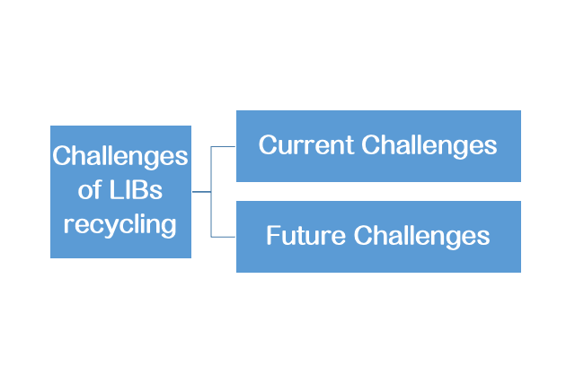
LIBs Recycling Current Situation: Technology

Slide 10
Technology:
Current Challenges
Waste Battery Reclamation
Pretreatments
Pyrometallurgy
Products
Improve Efficiency
Lower the Cost
Notes:
1.更结合实际
2.更结合产业链
3.有效的图片信息
4.技术的作用：降低成本？提高回收效率？怎么回收电池？

Slide 11
Technology:
Future Challenges
Solid State
Electrolyte
New Battery Systems
New Recycling Technologies and Strategies
Direct battery recycling
Li Metal
Electrode
Refresh battery materials
……
Notes:
1.更结合实际
2.更结合产业链
3.有效的图片信息
4.技术的作用：降低成本？提高回收效率？怎么回收电池？

Slide 12
Obstacle to collaboration
The US side of the story
Hostile policies against Chinese entities in EV supply chain | Chinese entities classified as foreign entities of concern and therefore excluded from the tax credits allocated to the EV industry in the Inflation Reduction Act and the Bipartisan Infrastructure Act Views Chines private entities and state-own entities as effective arms of government
Seeking strategic independence in critical minerals | Friendshoring the supply chain to countries with shared strategic interest and free trade agreement such as the G7 Policy direction focusing on empowering domestic battery manufacturing and domestic sources of critical minerals
Broad context of US China trade war | The US is trying to curb Chinese technological advancement and dominance in sensitive technology by restricting the export of software and technology transfer High tariffs and strong presence of sanctions on Chinese export to the US

Slide 13
Obstacle to collaboration
The Chinese side of the story
Strong state support for domestic EV industry | Substantial financial incentives, subsidies, and regulatory support have encouraged consumers and manufacturers to embrace electric vehicles. The development of charging infrastructure and research initiatives further solidify China's position as a global leader in the sector.
Distrust towards China-United States diplomatic relationship | Believes that the relationship should be based on peaceful coexistence guided by shared principles, consensus, and possible cooperation but frustrated over the confrontational stance from the US to suppress ‘China’s Threat’
Strong incentives to preserves dominance in the EV supply chain | Dominance in the extraction, processing, and production of rare earth materials and lithium batteries offers a unique advantage. This control over crucial elements of EV manufacturing grants China a strategic edge, as it ensures a consistent supply of essential materials.

Slide 14
Cases of successful bilateral US-China Collaboration
Ten Year Framework on Energy and Environment Cooperation
The United States and China agreed to establish a sixth goal on energy efficiency cooperation under the Ten Year Framework
Themes: Clean, Efficient and Secure Electricity Production and Transmission; Clean Water; Clean Air; Clean and Efficient Transportation; and Conservation of Forests and Wetlands Ecosystems
US China Science and Technology Cooperation agreement
U.S.-China science and technology activity increased in November 2009 with new agreements on joint projects in electric vehicles, or EVs, renewable energy
creation of the U.S.-China Clean Energy Research Center
cooperate in fields including agriculture, energy, space, health, environment, earth sciences and engineering, as well as educational and scholarly exchanges.
expired in Feb 2024 but temporarily extended for another 6 months

Slide 15
Recommendation：how to stimulate cooperation
Joint R&D and Standardization
Resource Circulation and Supply Chain Security
Environmental Governance and Sustainable Development Goals
Market Rules and Trade Cooperation

Slide 16
Thanks for your attention
Presented by Energy Group

